Slide 1
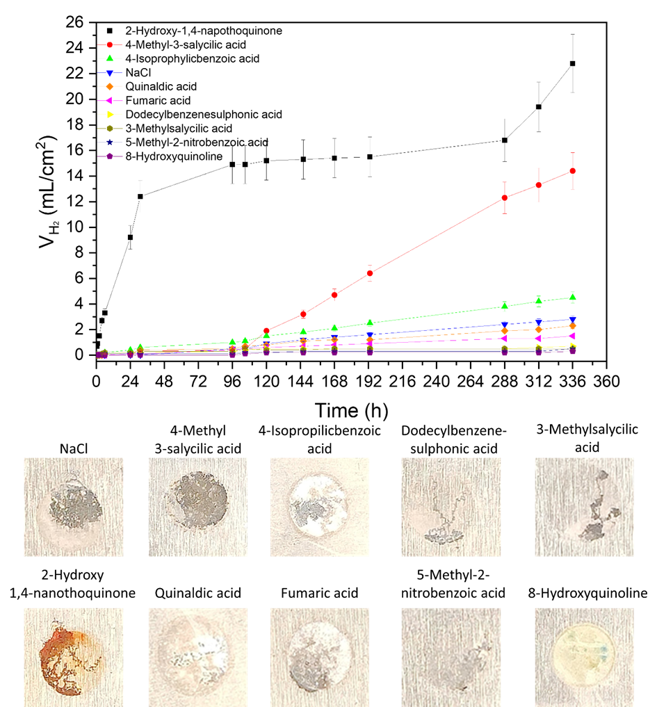
Figure 1. Volume of hydrogen evolved from the cathodic reaction during immersion in 0.5 wt.% NaCl solution and surface appearance of the exposed area after the test.

Slide 2
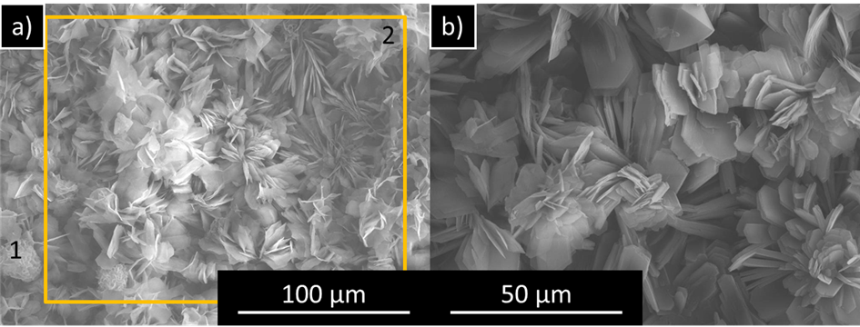
Figure 2. (a) Surface morphology of bare AZ31 exposed to 0.5 wt.% NaCl containing 8HQ after 14 days. A higher magnification view of the flakes is presented in (b). Marked areas corresponds to the EDS analysis collected in Table 2.

Slide 3
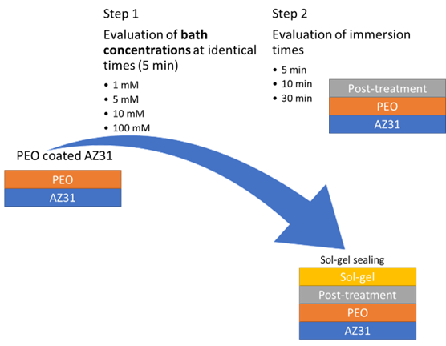
Figure 3. Steps for the optimization of the inhibitor post–treatment prior to sol–gel sealing.

Slide 4
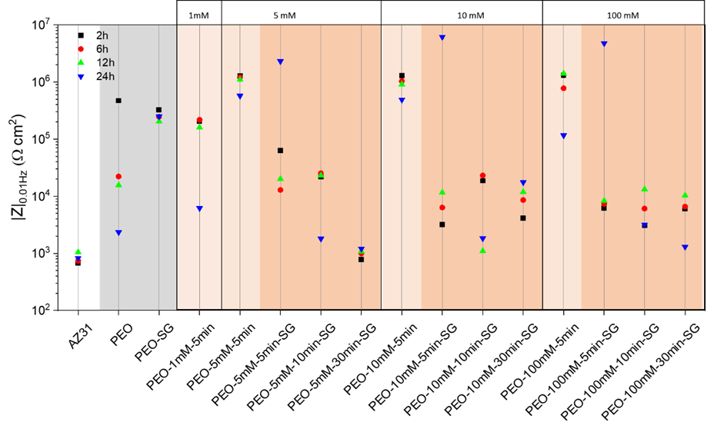
Figure 4. Scatter diagram of impedance modulus at 0.01 Hz in 0.5 wt.% NaCl of the selected coatings on AZ31 alloy.

Slide 5
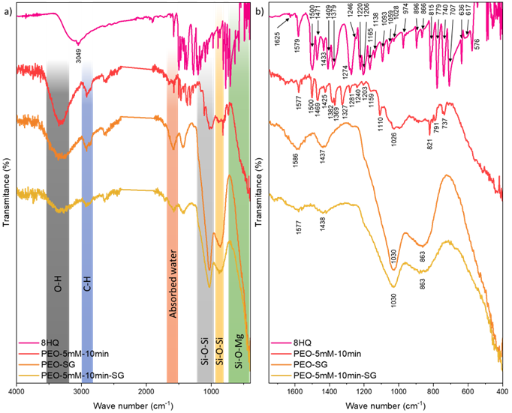
Figure 5. (a) FTIR spectra of 8HQ powder and studied coatings and (b) detail of the near IR region. A representative concentration of the 8HQ was used for FTIR study.

Slide 6
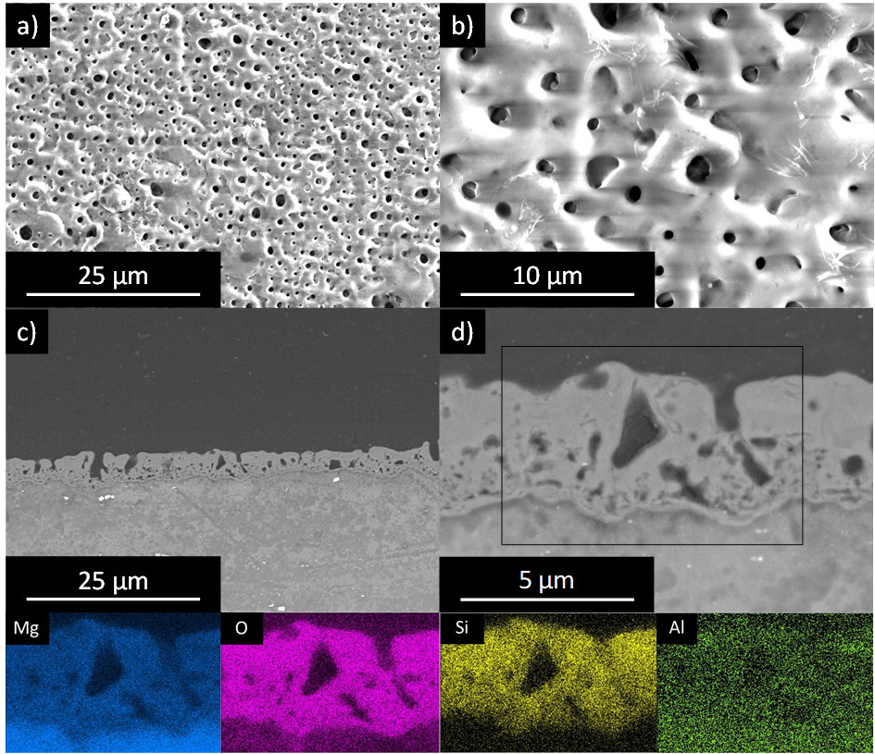
Figure 6. Scanning electron micrographs corresponding to the (a,b) planar and (c,d) cross views of PEO coated AZ31. Cross–section observation along with EDS mapping of the PEO layer.

Slide 7
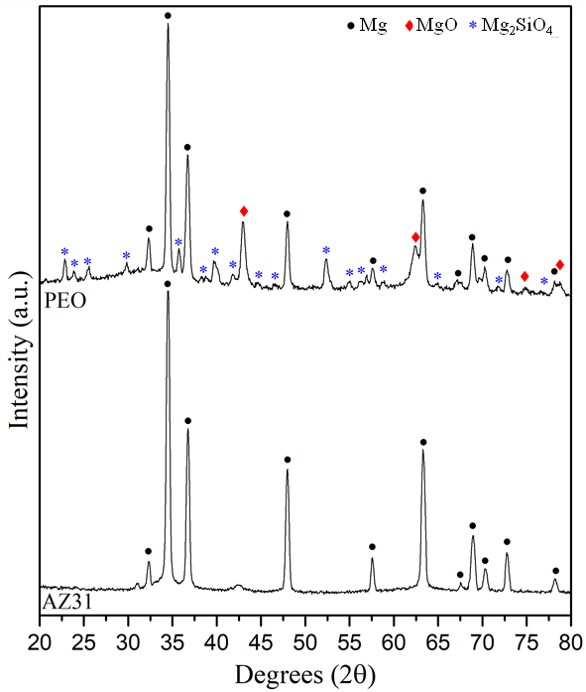
Figure 7. XRD patterns of bare alloy and the fabricated PEO coating.

Slide 8
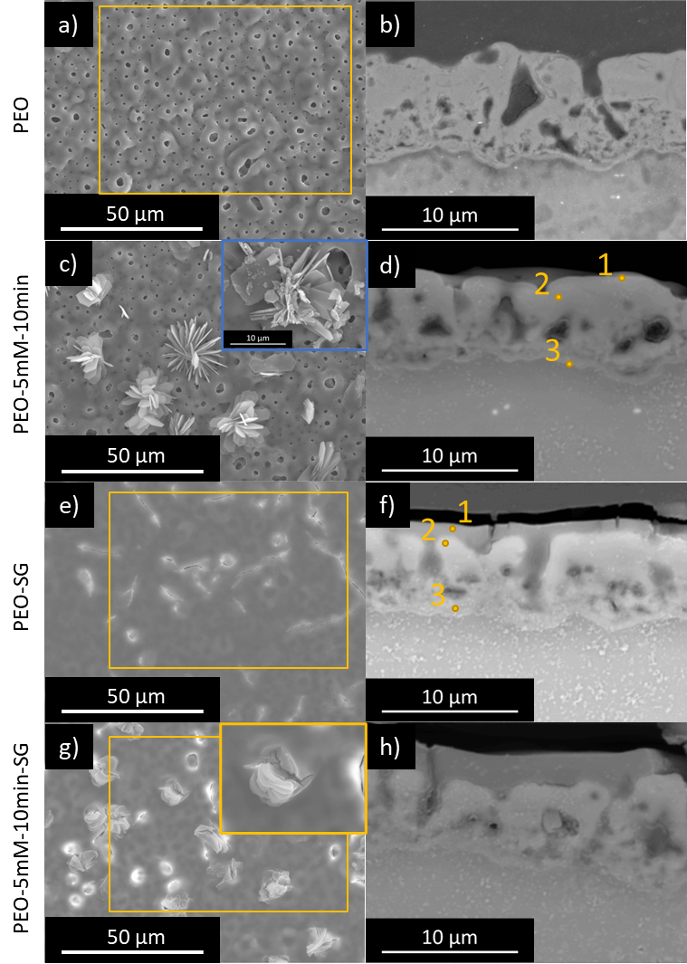
Figure 8. Scanning electron micrographs corresponding to the planar and cross views of (a,b) PEO, (c,d) PEO–5mM–10min, (e,f) PEO–SG and (g,h) PEO–5mM–10min–SG. Corresponding EDS analysis are collected in Table 47.

Slide 9
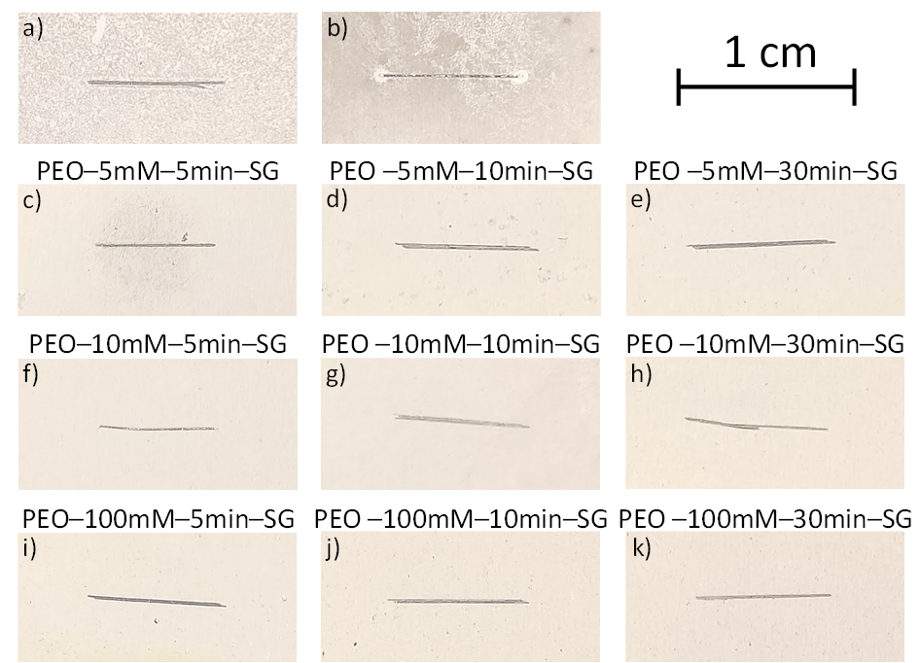
Figure 9. Digital images of (a) PEO, (b) PEO–SG and (c–k) PEO–8HQ–SG scribed coatings after 14 days of immersion in 0.5 wt.% NaCl solution at room temperature.

Slide 10
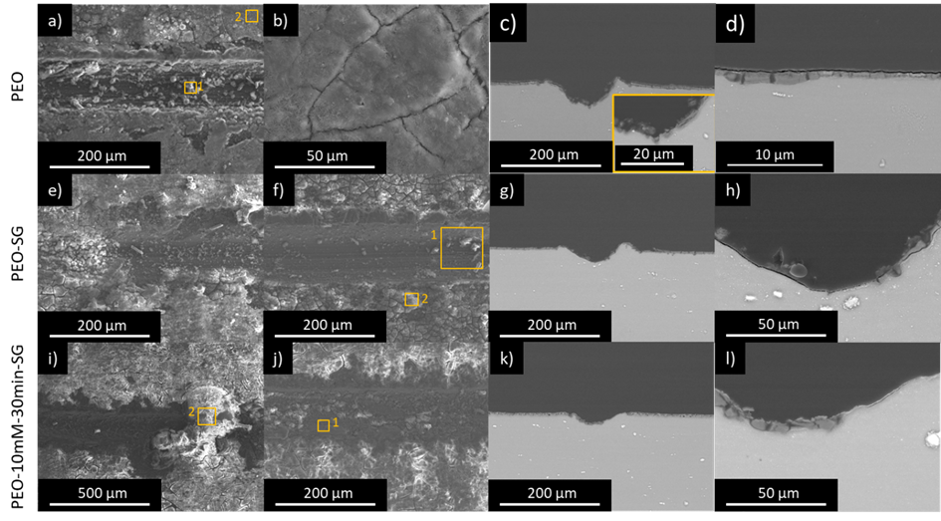
Figure 10. SEM microscopy images of (a–d) PEO, (e–h) PEO–SG and (i–l) PEO–10mM–30min–SG scribed coatings after 14 days immersion test in 0.5 wt.% NaCl solution at room temperature.

Slide 11
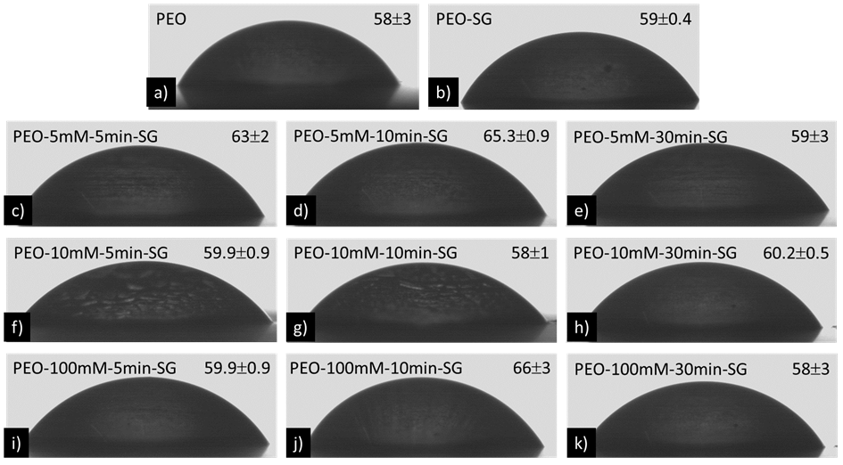
Figure 11. Water contact angle measurements: (a) PEO, (b) PEO–SG and (c–k) PEO–8HQ–SG.

Slide 12
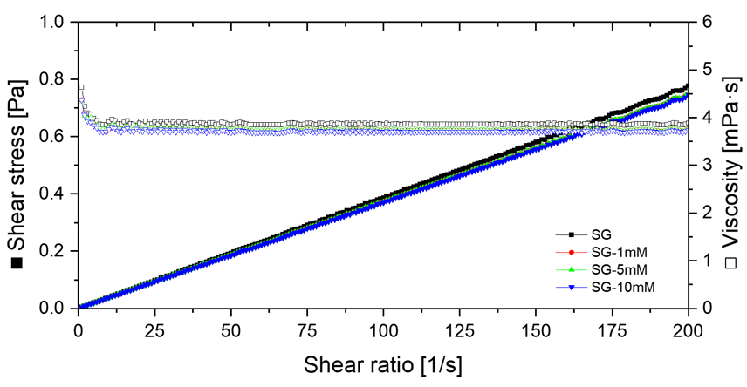
Figure 12. Flow curves for various 8HQ concentrations in the sol–gel solutions.

Slide 13
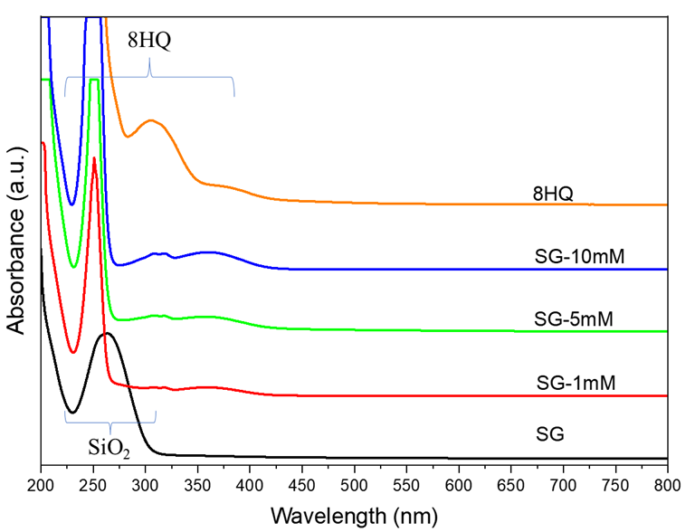
Figure 13. UV–Visible spectra of the sol–gel solutions for various concentrations of 8HQ corrosion inhibitor.

Slide 14
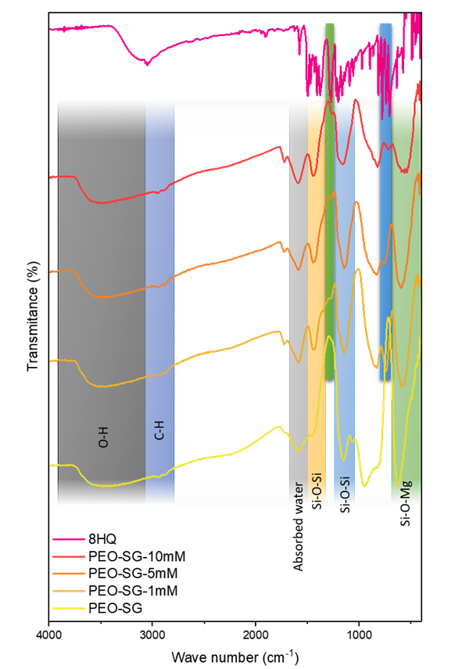
Figure 14. FTIR spectra of PEO–SG–8HQ systems on AZ31 alloy. The spectra of PEO–SG coating and 8HQ powder are included for reference.

Slide 15
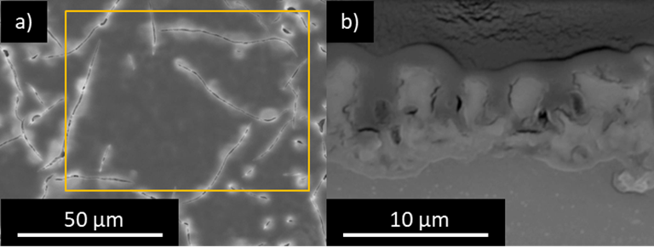
Figure 15. Scanning electron micrographs corresponding to the (a) planar and (b) cross views of PEO–SG–1mM coated AZ31. Results of the local EDS surface analysis of the coatings (at.%) are: C 36.3 , O 38.8, Na 0.3, Mg 9.9, Al 0.3, Si 13.4 and K 0.1.

Slide 16
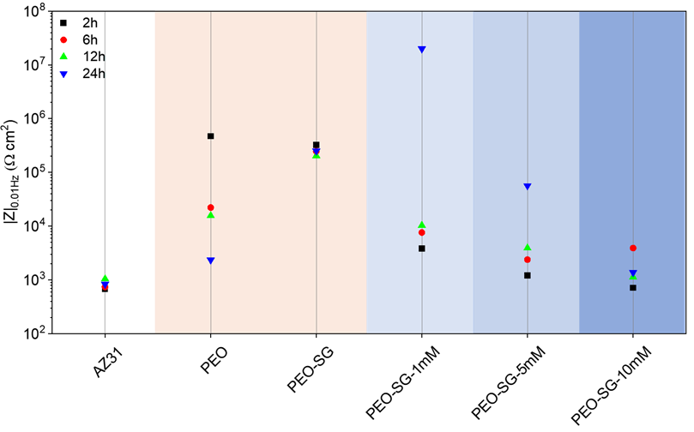
Figure 16. Scatter diagram of impedance modulus at 0.01 Hz in 0.5 wt.% NaCl of the PEO–SG coatings with 1, 5 and 10 mM 8HQ in the sol–gel layer. The diagram also includes the reference coatings (PEO and PEO–SG).

Slide 17
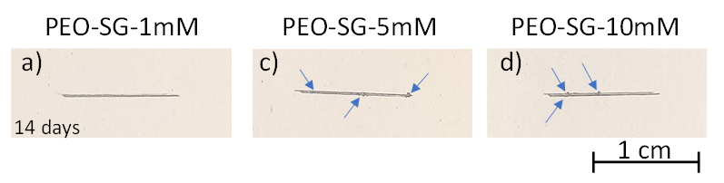
Figure 17. Digital images of PEO–SG–8HQ scribed coatings after 14 days of immersion in 0.5 wt.% NaCl solution at room temperature.

Slide 18
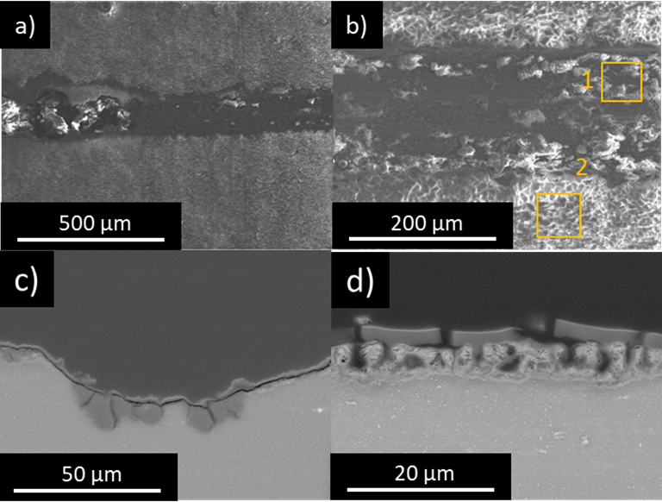
Figure 18. SEM microscopy images of PEO–SG–1mM scribed coatings after 14 days immersion test in 0.5 wt.% NaCl solution at room temperature.

Slide 19
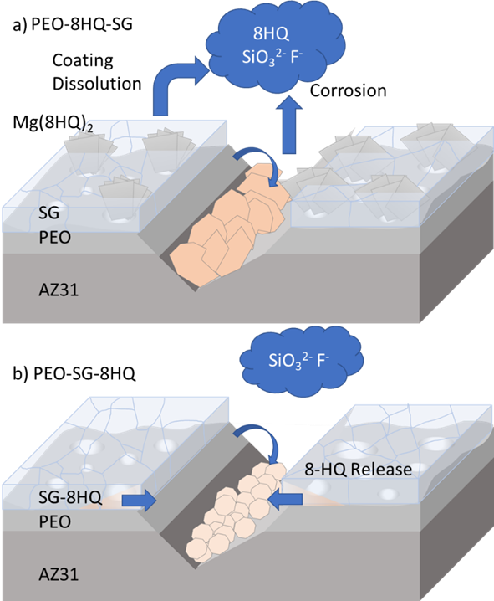
Figure 19. Schematic illustration of the corrosion mechanism for scratched (a) PEO–8HQ–SG and (b) PEO–SG–8HQ coatings on AZ31 Mg alloys.

