Slide 1
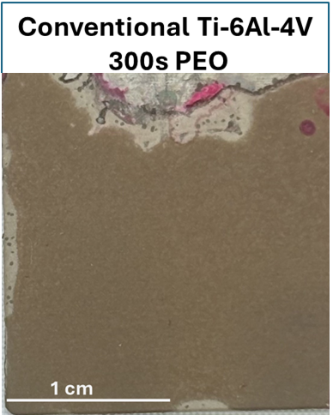
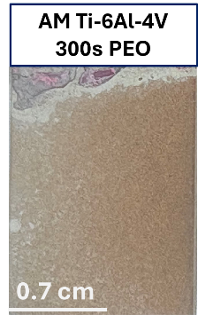
Soft sparking area
Supplementary Figure S1. Macrographs of the PEO treated Ti6Al4V alloy samples (300 s) showing the extent of the sample area affected by soft sparking.

Slide 2
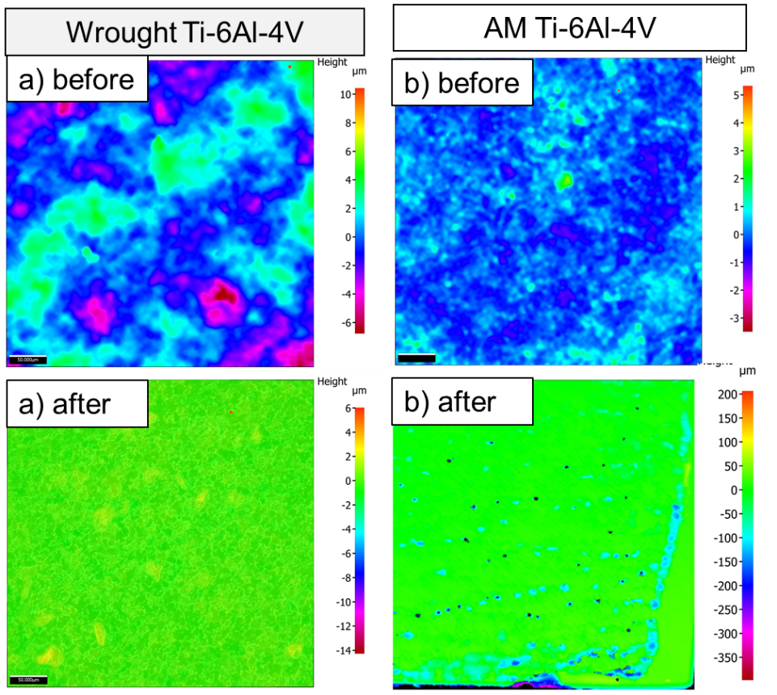
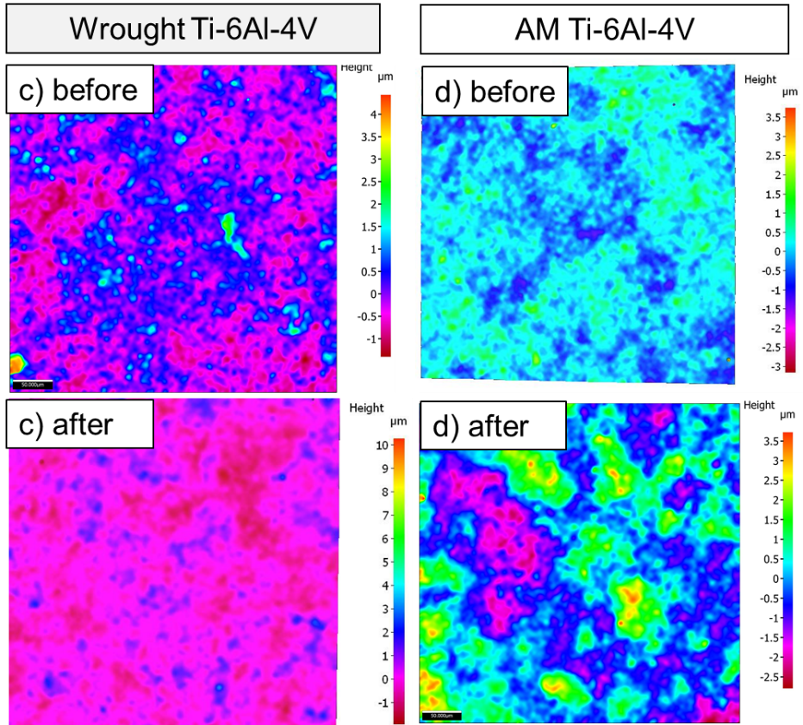
Supplementary Figure S2. 2D topographical mapping obtained by optical profilometry of the bare and coated alloys before and after 30 d of immersion in SBF and corrosion testing: a, b) bare substrates, c, d) flash-PEO coated substrates, e, f) PEO-coated substrates.

Slide 3
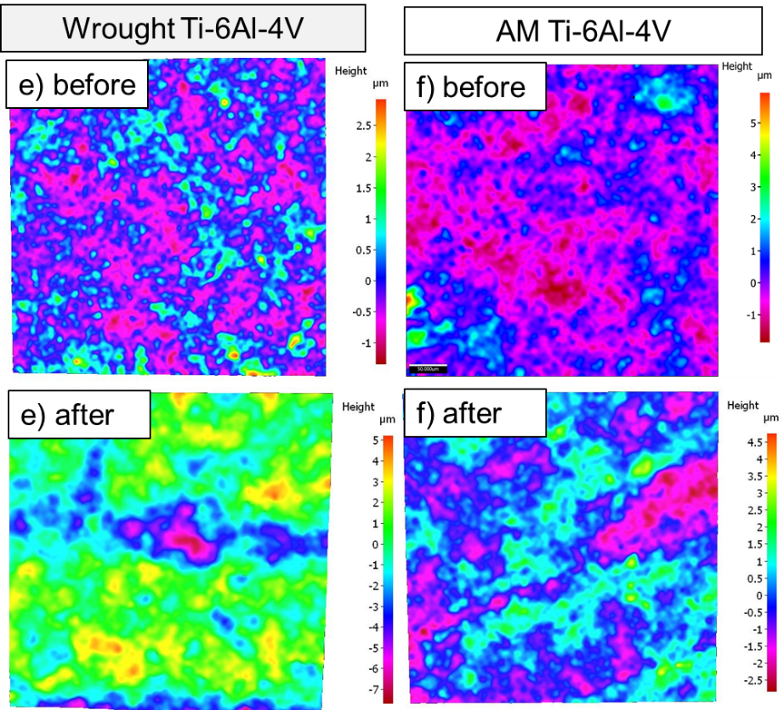
Supplementary Figure S2. (continued). 2D topographical mapping obtained by optical profilometry of the bare and coated alloys before and after 30 d of immersion in SBF and corrosion testing: a, b) bare substrates, c, d) flash-PEO coated substrates, e, f) PEO-coated substrates.

