Slide 1
Biological Performance of Duplex PEO + CNT/PCL Coating on AZ31B Mg Alloy for Orthopedic and Dental Applications

Slide 2
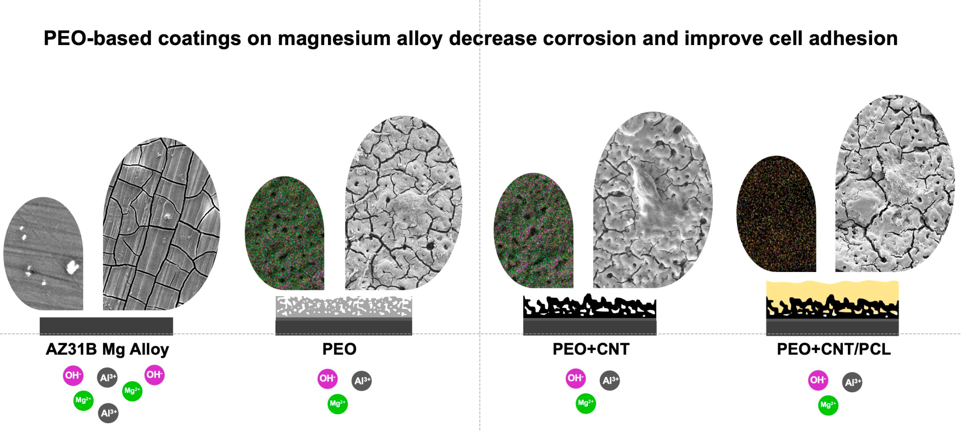
Graphical Abstract

Slide 3
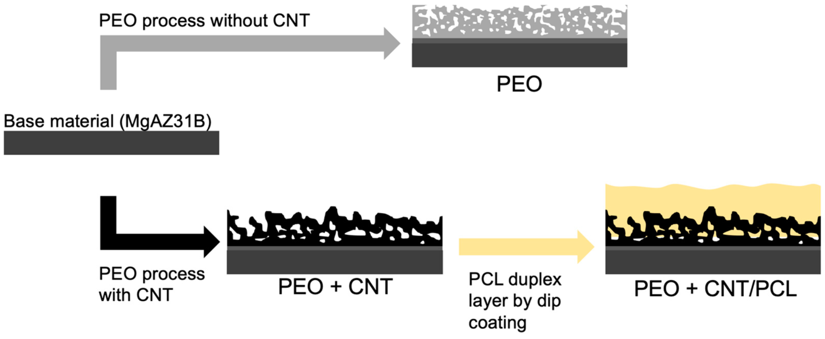
Figure 1. Schematic summary of the coating development procedures.

Slide 4
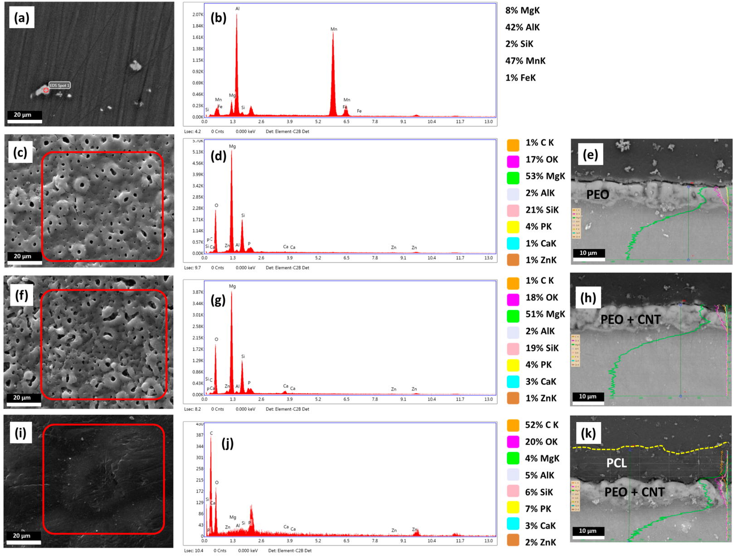
Figure 2. Characterization of Mg alloy surfaces. The SEM micrograph depicting the surface of BM (a), EDS point analysis of BM (b), SEM micrograph of PEO surface (c), EDS analysis of the selected PEO area (d), PEO cross-section EDS-Line (e), SEM micrograph PEO + CNT surface (f), EDS analysis of the selected PEO + CNT area (g), PEO + CNT cross-section EDS-Line (h), SEM micrograph of PEO + CNT/PCL surface (i), EDS analysis of the selected PEO + CNT/PCL area (j), PEO + CNT/PCL cross-section EDS-Line (k). The percentages of elements based on EDS analysis are depicted. The semi-quantitative EDS analysis results are given in %.

Slide 5
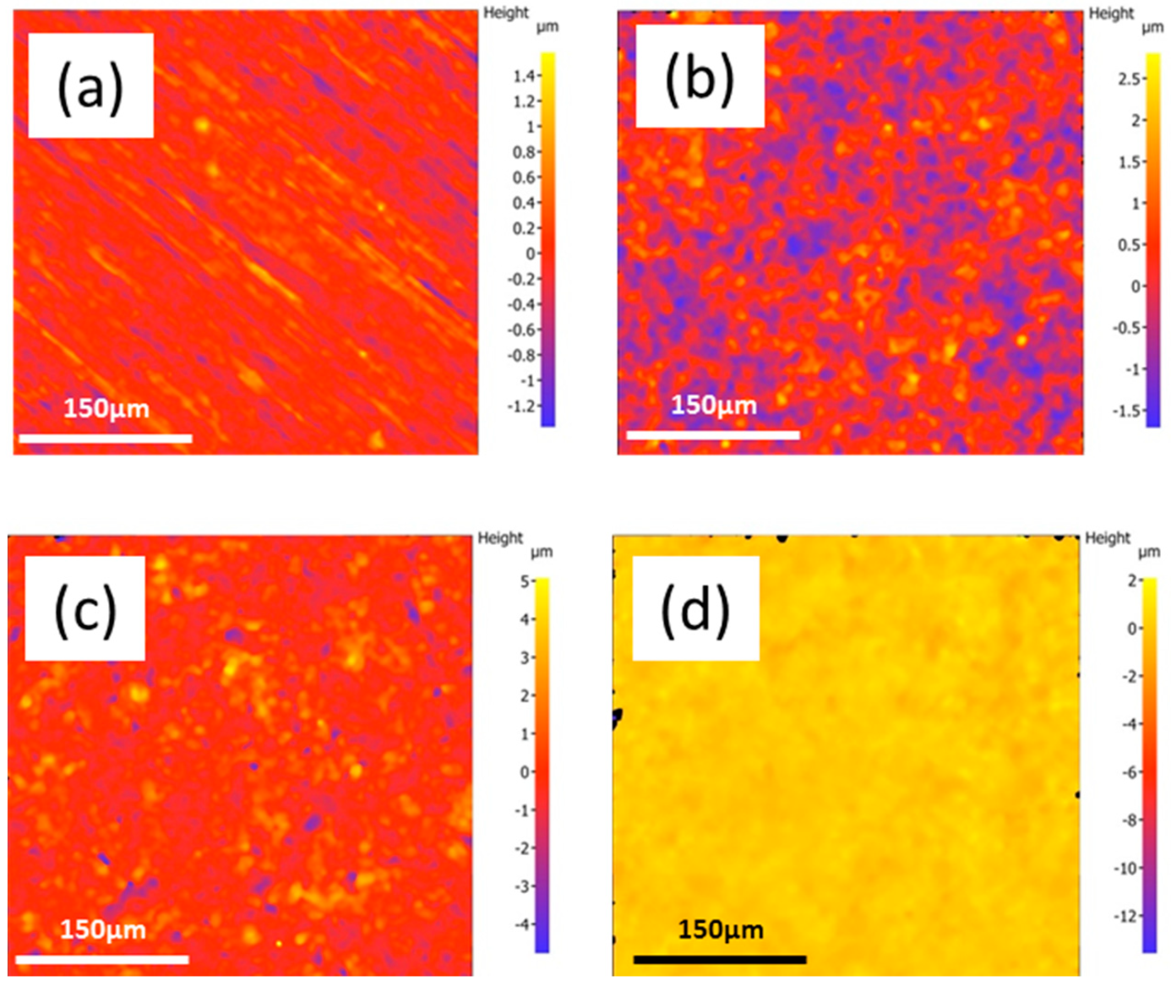
Figure 3. Evaluation of surface topography. Two-dimensional optical images showing the topography of the BM (a) PEO, (b) PEO + CNT (c), and PEO + CNT/PCL (d) coatings. Please note the differences in the sidebar reference scale.

Slide 6
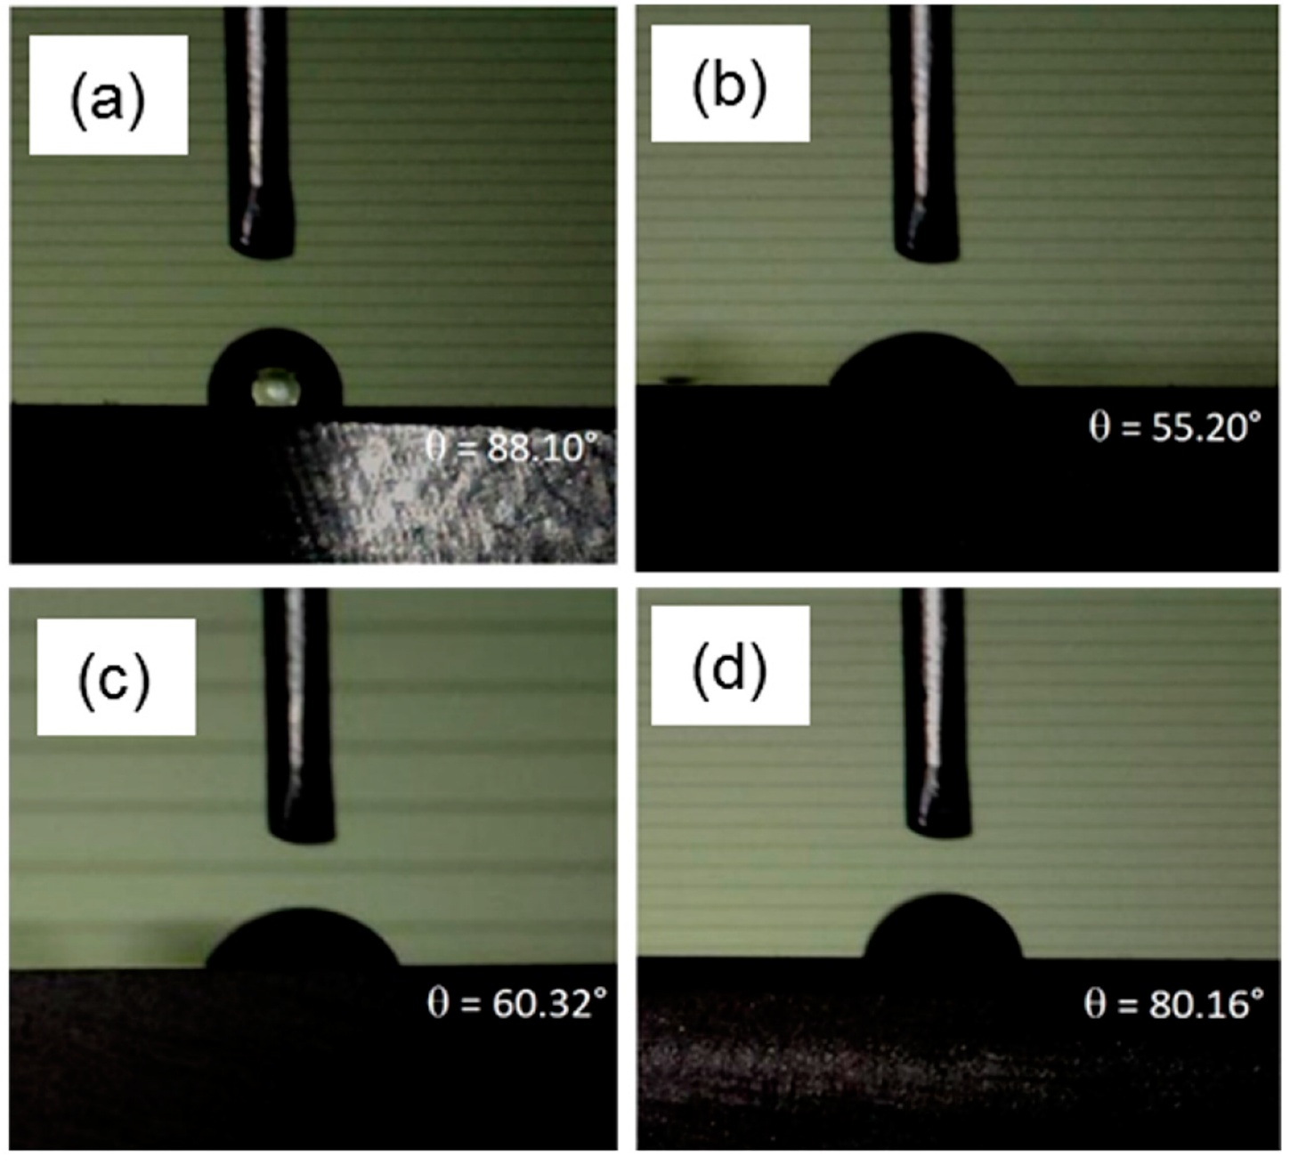
Figure 4. Contact angles for different magnesium surfaces. Contact angles were measured on (a) BM, (b) PEO, (c) PEO + CNT, and (d) PEO + CNT/PCL surfaces.

Slide 7
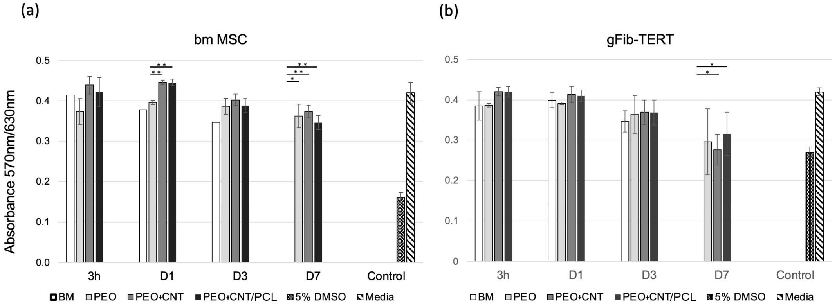
Figure 5. Cell metabolism on different surfaces. Bone marrow MSCs (a) and gFib-TERTs (b) metabolism expressed as an absorbance ratio measured at 570 nm and 630 nm. Cells were exposed for 24 h to the culture media collected upon incubation with BM, PEO, PEO + CNT, and PEO + CNT/PCL for 3 h, 1, 3, and 7 days. Controls comprised exposure to 5% DMSO (positive control) and fresh cell culture media (negative control). Significant differences (p < 0.05) are indicated: * for p < 0.05, and ** for p < 0.01.

Slide 8
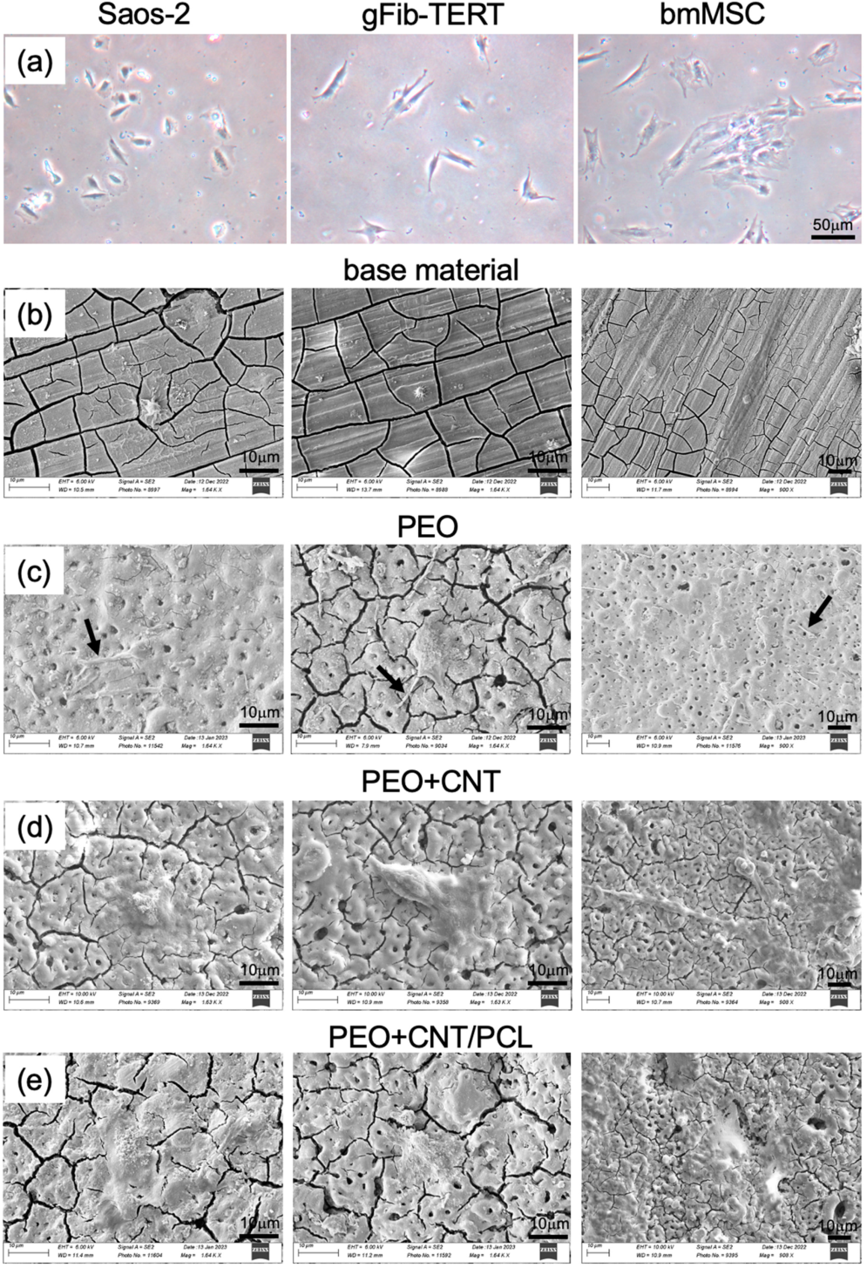
Figure 6. Cell adhesion and spreading on different surfaces. Phenotypic appearance of osteoblastic cell line Saos-2, oral gingival fibroblasts gFib-TERTs, and bone marrow MSCs on tissue culture plate (a), base material (b), PEO (c), PEO + CNT (d), and PEO + CNT/PCL (e) after 24 h. Filopodia are indicated with arrows.

