Slide 1
Figure 1. (a) Current density-time curves and (b) calculated apparent specific energy consumption for PEO-T (black-squares) and PEO-S (red-circles) coatings on Mg3Zn0.4Ca alloys.

Slide 2
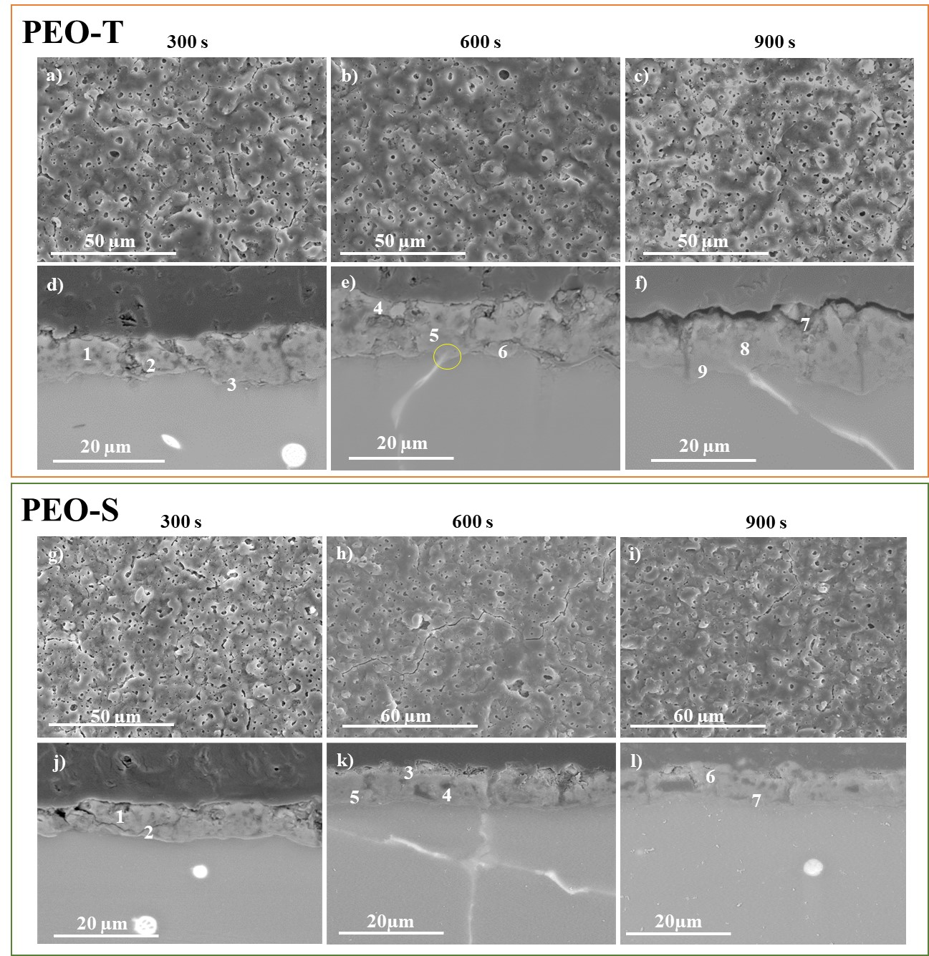
Figure 2. Secondary electron micrographs of surface (a-c, g-i) and cross-sectional (d-f, j-l) morphology of the (a-f) PEO-T and (g-l) PEO-S coatings produced on Mg3Zn0.4Ca alloys in: 300 s (a, d, g, j), 600 s ( b, e, h, k) and 900 s (c, f, i, l).

Slide 3
Figure 3. TEM micrographs of PEO-S coating acquired at 200 kV from different regions of barrier layer. (a) Lower magnifications, (b, c) higher magnifications and (c) detail of barrier layer of Figure 3 (b).

Slide 4
Figure 4. XRD patterns of (a) PEO-T and (b) PEO-S coatings on Mg3Zn0.4Ca alloy.

Slide 5
Figure 5. Polarization curves of (a) PEO-T and (b) PEO-S coatings on Mg3Zn0.4Ca alloy at 300, 600 and 900 s treatment time.

Slide 6
Figure 6. Scatter diagram of the total impedance modulus values for that substrate and the studied PEO coatings.

Slide 7
Figure 7. Nyquist and Bode plots of (a) PEO-T and (b) PEO-S coatings for Mg3Zn0.4Ca alloys after 1 h of immersion in α-MEM solutions at 37ºC. (c) Equivalent circuit used to fit EIS. Symbols - open for PEO-T and filled for-PEO-S coatings and colour associated to treatment time: black -300 s, red - 600 s and blue -900 s.

Slide 8
Figure 8. Hydrogen evolution of PEO-T and PEO-S coatings for the alloy in inorganic α-MEM solution at 37ºC controlling pH at 7.4: (a) for 120 h; (b) amplification for the initial 3 h.

Slide 9
Figure 9. (a, e) Macrographs and cross-section of (b, c) PEO-T and (f, g) PEO-S coatings for Mg3Zn0.4Ca after 5 days of immersion in modified α-MEM solution. (d, h) EDS analysis (at. %) of PEO-T and PEO-S after H₂ evolution test.

Slide 10
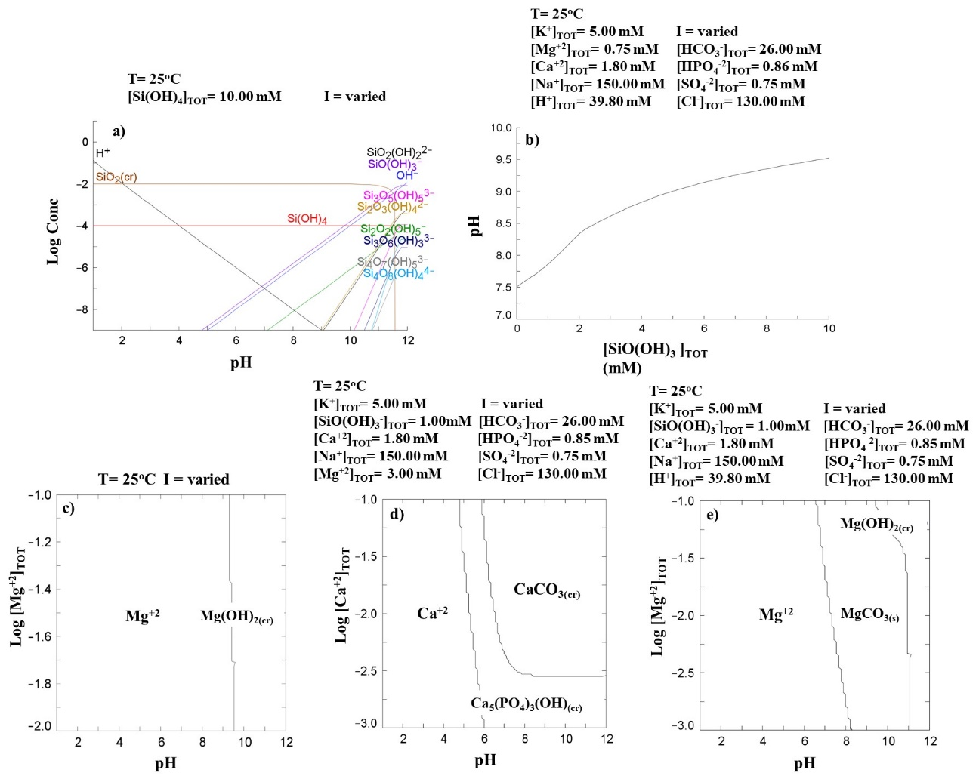
Figure 10. Equilibrium diagrams for (a) silicate species and (b) modified α-MEM solution in presence of hydrolysed silica species. (c) Solubility diagram for Mg species. Predominance area diagrams for (d) Ca and (e) Mg species in α-MEM.

