Slide 1
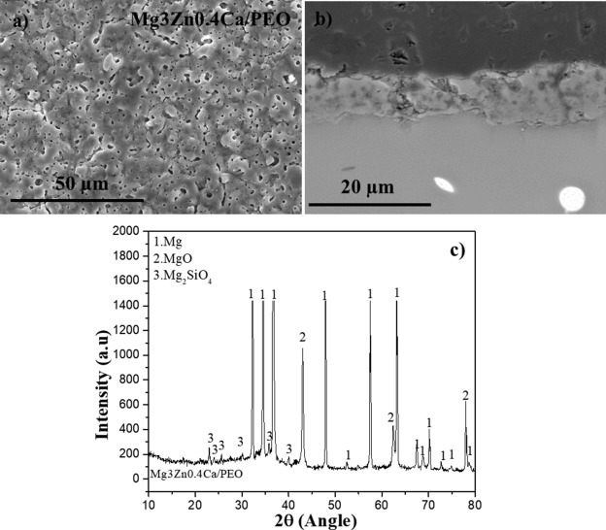
Fig. 1. (a) Surface and (b) cross-section SEM micrograph of the PEO coating in Mg3Zn0.4Ca alloy. (c) XRD pattern of PEO coating.

Slide 2
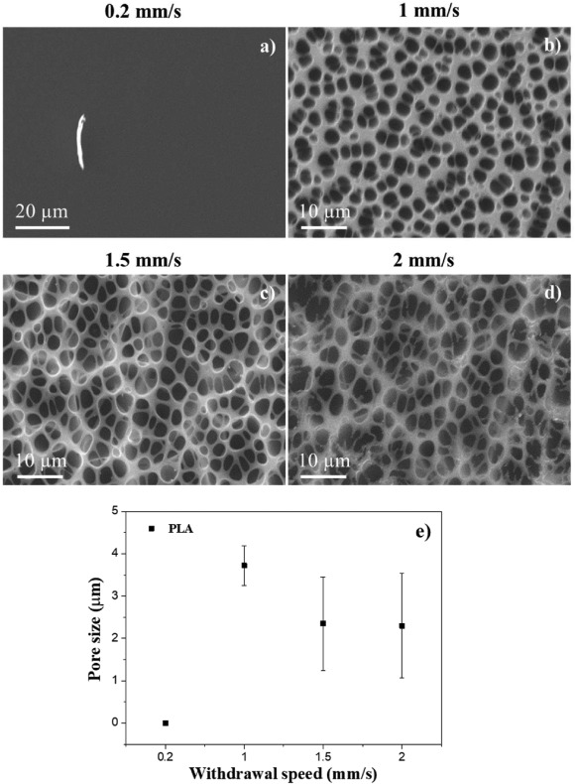
Fig. 2. (a–d) Evaluation of the withdrawal speed of dip coating of 3D PLA printed pieces in PLA polymer solution. (e) Evolution of average of pore size.

Slide 3
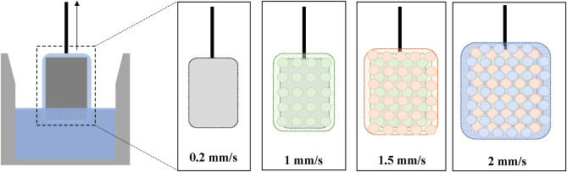
Fig. 3. Scheme of the formation of PLA layer at several withdrawal speeds.

Slide 4
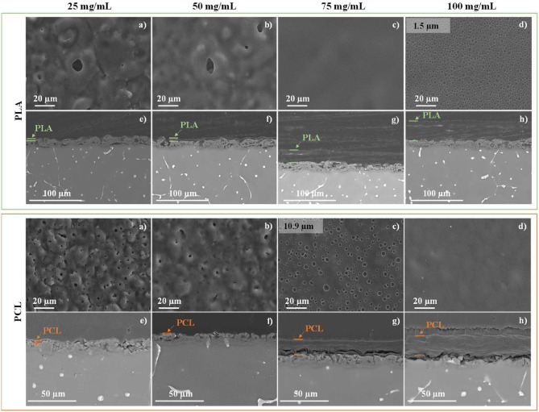
Fig. 4. (a–d) Secondary electron top view image and (e–h) backscattered electron secondary electron cross-section images of PLA and PCL on PEO-coated samples at 25, 50, 75 and 100 mg/mL.

Slide 5
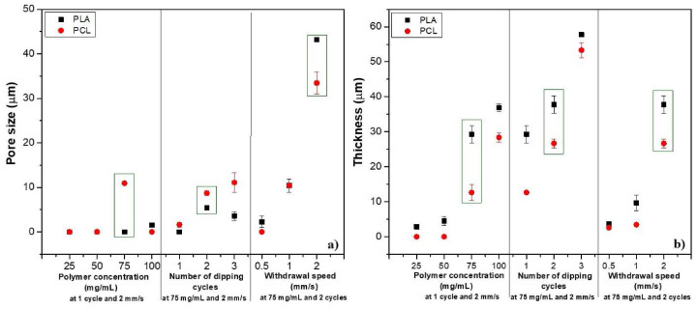
Fig. 5. Variation of (a) pores size and (b) thickness at different conditions of studied as polymer concentration, number of dipping cycles and withdrawal speed.

Slide 6
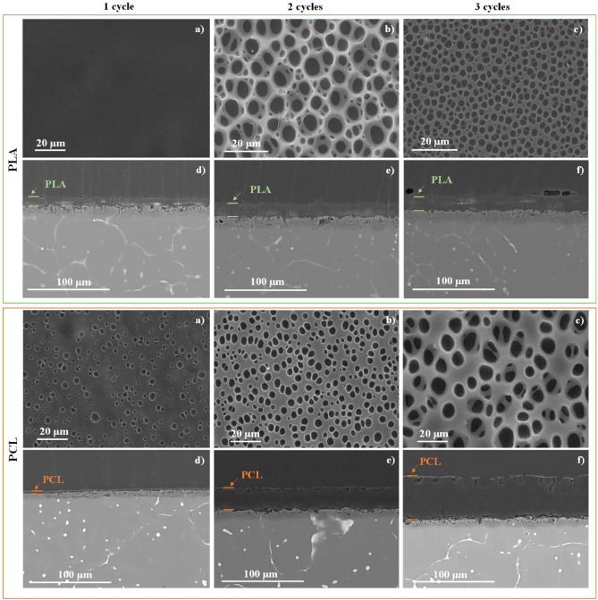
Fig. 6. (a–c) Secondary electron top view and (d–f) backscattered electron cross-section images of PLA and PCL on PEO-coated samples at 1, 2 and 3 cycles at 75 mg/mL of polymer concentration and 2 mm/s.

Slide 7
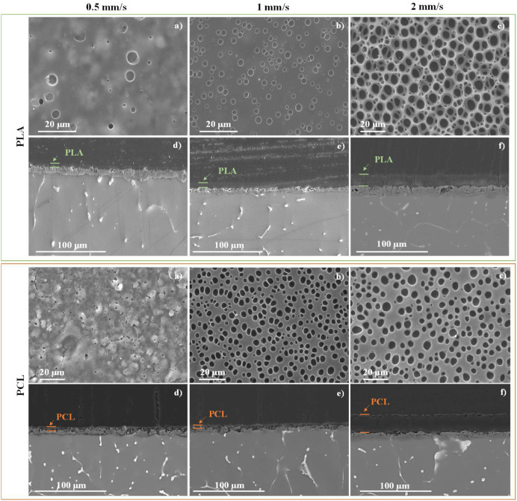
Fig. 7. (a–c) Secondary electron top view and (d–f) backscattered electron cross-section images of PLA and PCL on PEO-coated samples at withdrawal speed of 0.5, 1 and 2 mm/s at 75 mg/mL of polymer concentration and 2 cycles.

Slide 8
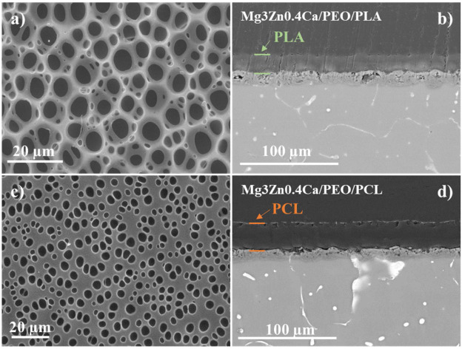
Fig. 8. (a, c) SE plan view micrographs and (b, d) BSE cross-section of SEM images for (a, b) PLA/-coated Mg3Zn0.4Ca and (c, d) PCL/PEO-coated Mg3Zn0.4Ca at 75 mg/mL, 2 cycles and 2 mm/s of withdrawal speed.

Slide 9
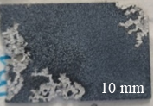
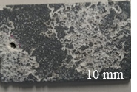
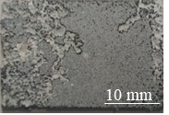
Fig. 9. Hydrogen evolution of Mg3Zn0.4Ca, PEO and PCL-coated specimens after 13 days of immersion in inorganic part of α-MEM at 37 °C.

Slide 10
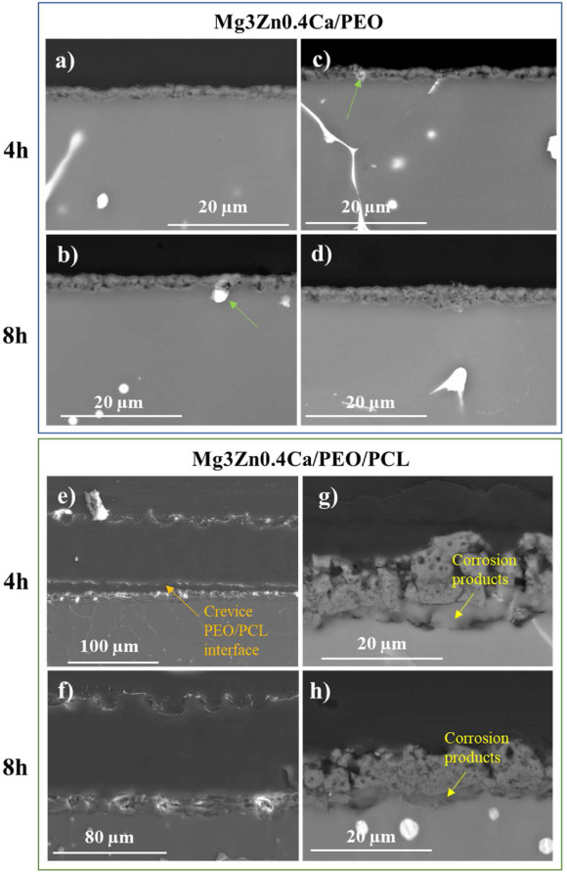
Fig. 10. Backscattered cross-section images of (a–d) PEO treated surface and (e–h) PCL-coated samples after (a, c, e, g) 4 h, and (b, d, f, h) 8 h of immersion in inorganic α-MEM at 37 °C.

Slide 11
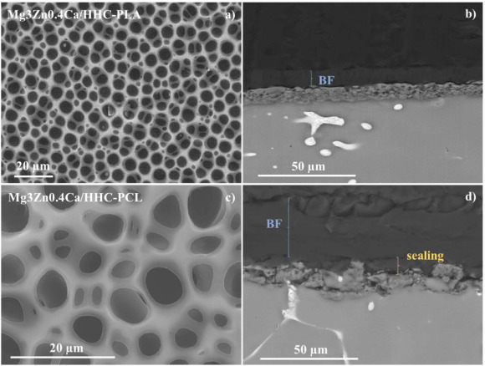
Fig. 11. SEM images of (a, c) secondary electron top view and (b, d) backscattered cross-section images of (a–c) HHC-PLA and (d–f) HHC-PCL-coated samples.

Slide 12
Fig. 12. Hydrogen evolution of bulk material, PEO, PLA and PCL-coated samples after 17 days of immersion at 37 °C.

Slide 13
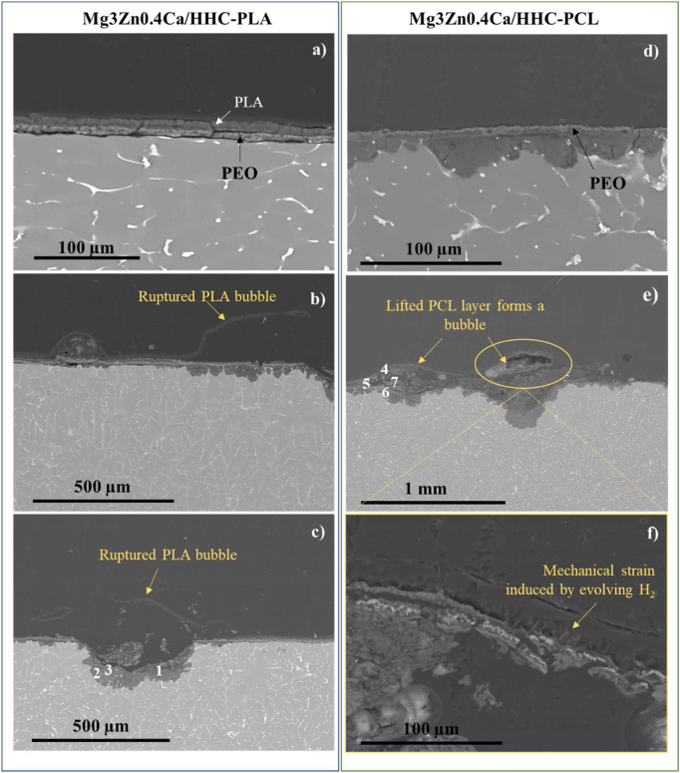
Fig. 13. Secondary-electron cross-section image of PLA- (a–c) and PCL- (d–f) based HHC on Mg3Zn0.4Ca alloy after 17 days of immersion in inorganic α-MEM solution. (c, e) EDS analysis of the corrosion products from PLA and PCL-coated specimens.

